Slide 1
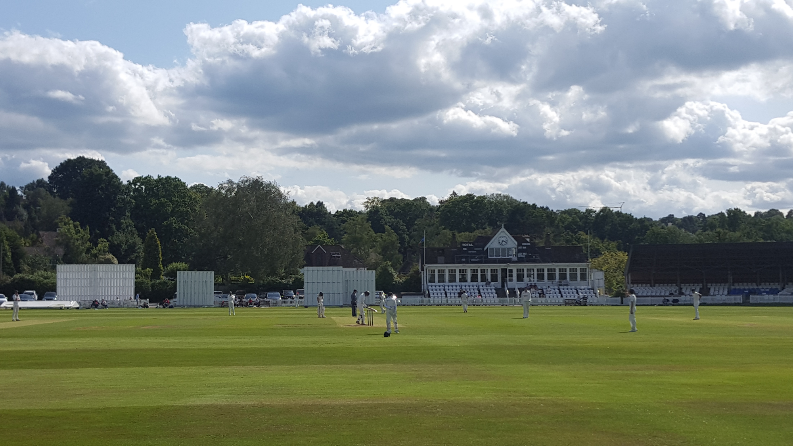
The History of the Tunbridge Wells Colts Festival since 1979

Slide 2
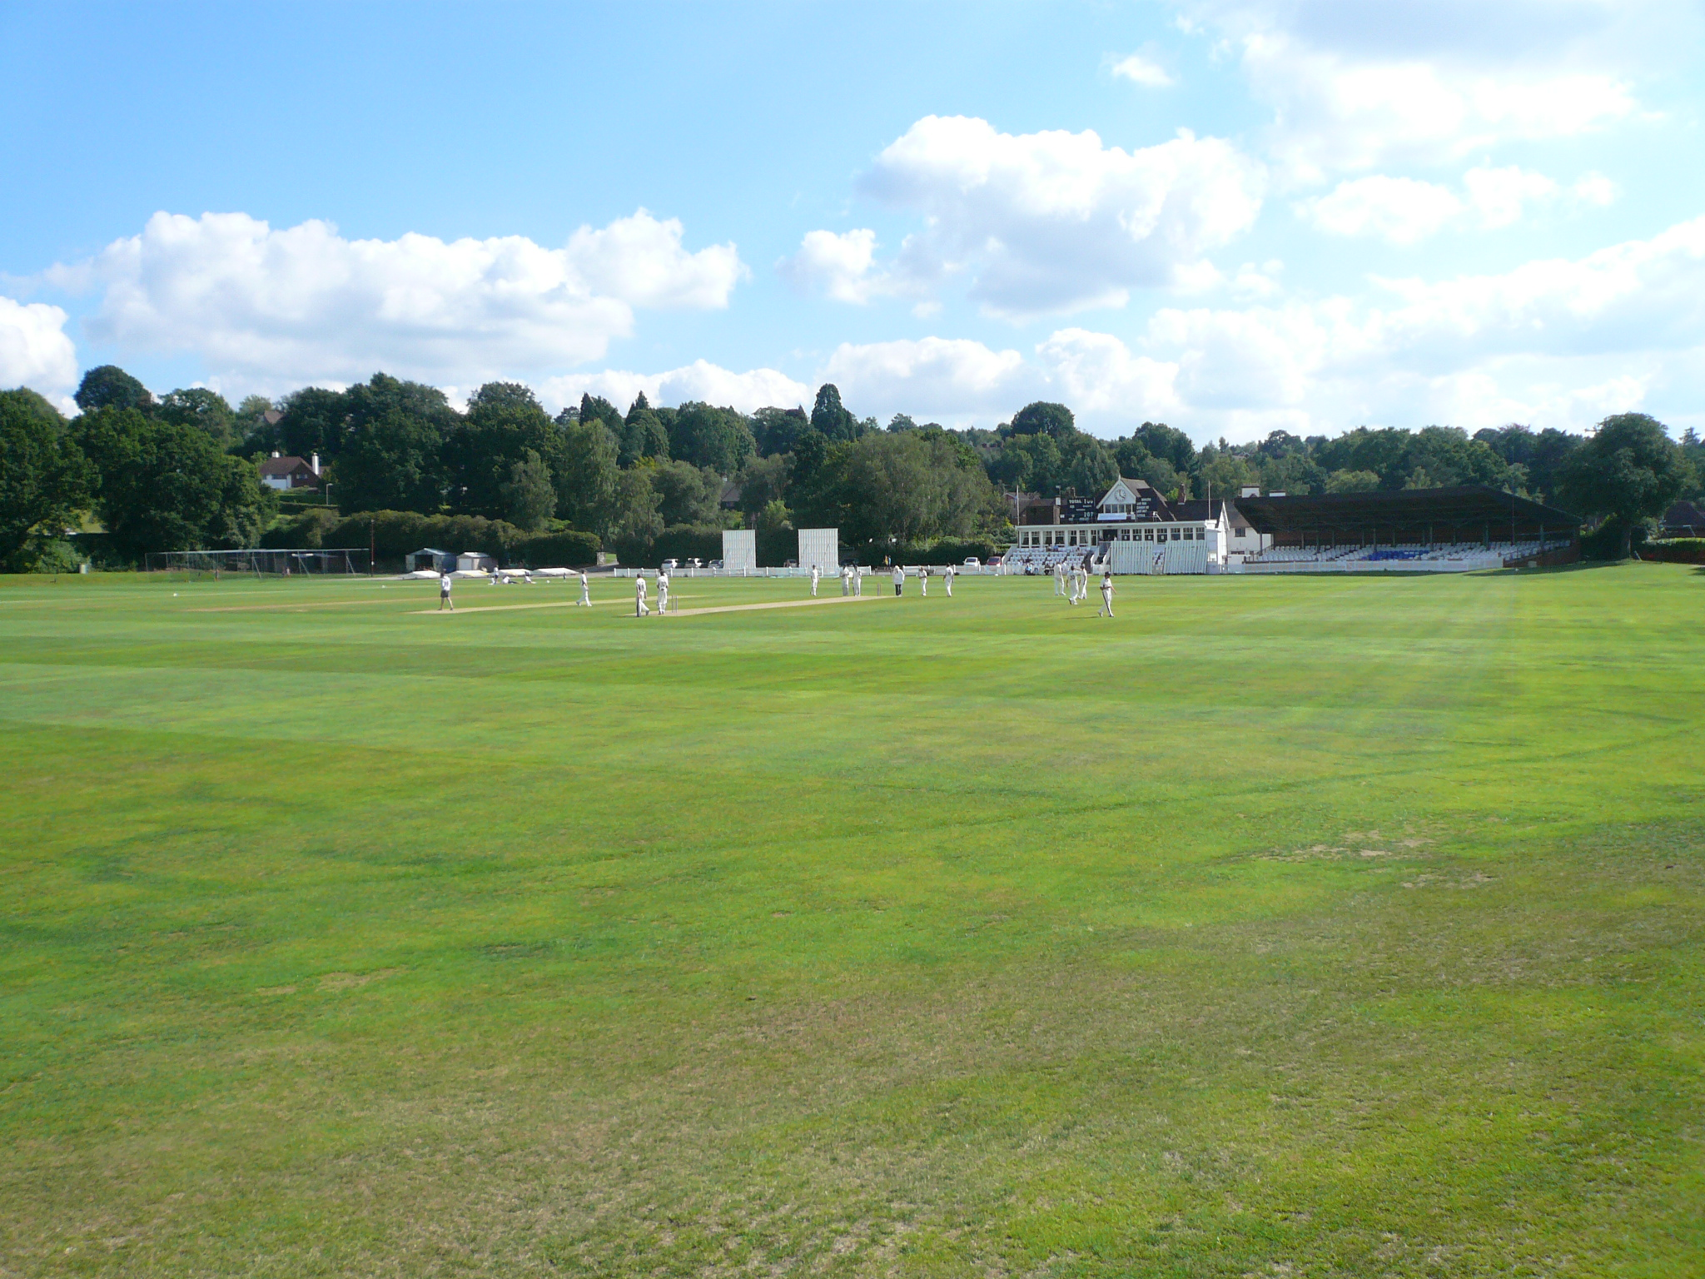
Introduction
In 1978 the late Jonathan Langdale and Mike Gibb from the Tunbridge Wells CC conceived and planned the Festival. Jonathan was responsible for the day to day running of it and Mike the pre Festival admin. 1979 saw the first Festival with four clubs Tunbridge Wells, Bexley, Holmesdale and Sevenoaks Vine participating over four days at the Nevill Cricket Ground. The aims of the Festival was just that, a Festival of cricket providing opportunities for young players to play longer matches of 40 overs per innings with a bowling limit of 9 overs per bowler. There was also a unique age ruling introduced where all players had to be under the age of 17 by 1st March. Individual performance awards for batting, bowling, wicketkeeping and fielding were introduced at various stages of the Festival. Shortly afterwards, the Festival became an 8 team tournament following invitations to Dartford, Bromley, Gravesend and Beckenham. This operated through two groups of 4 teams and matches being played both morning and afternoon and on both pitches at the Nevill. Sidcup replaced Gravesend in 1983 before being replaced by the Border League XI. Gore Court replaced Holmesdale in 1988. Group matches retained the 40 overs per innings format with a limit of 9 overs per bowler. Five points were awarded for a win, three points for a winning draw and one point awarded for a losing draw. The top team would progress to the final and the second placed team would play in the 3rd/4th play off match on the top pitch. Each game on the finals day would be 90 over matches (45 overs each) with a 10 overs per bowler. After Jonathan Langdale & Mike Gibb stood down, the Festival was run by the Kent Cricket Board in 1999 & 2000 and the Festival became an under 16 age group tournament and new clubs including Hayes and Lordswood were invited to participate. The lack of sponsor resulted in the Festival returning to its Tunbridge Wells CC roots in 2001. The under 17 by the 1st March ruling was reinstated until around 2003, then the Festival became a fully under 17 Festival based on the school year. The playing format has shifted over time where the group matches are now 35 overs each and a win/lose point system has been introduced. Both the Final and the 3rd & 4th play-off have remained 45 overs each. Sadly, the visionary Jonathan Langdale is no longer with us, David Marshall and others are to be thanked for continuing to run this wonderful Festival in Jonathan’s memory and to provide wonderful cricket opportunities for young cricketers.

Slide 3
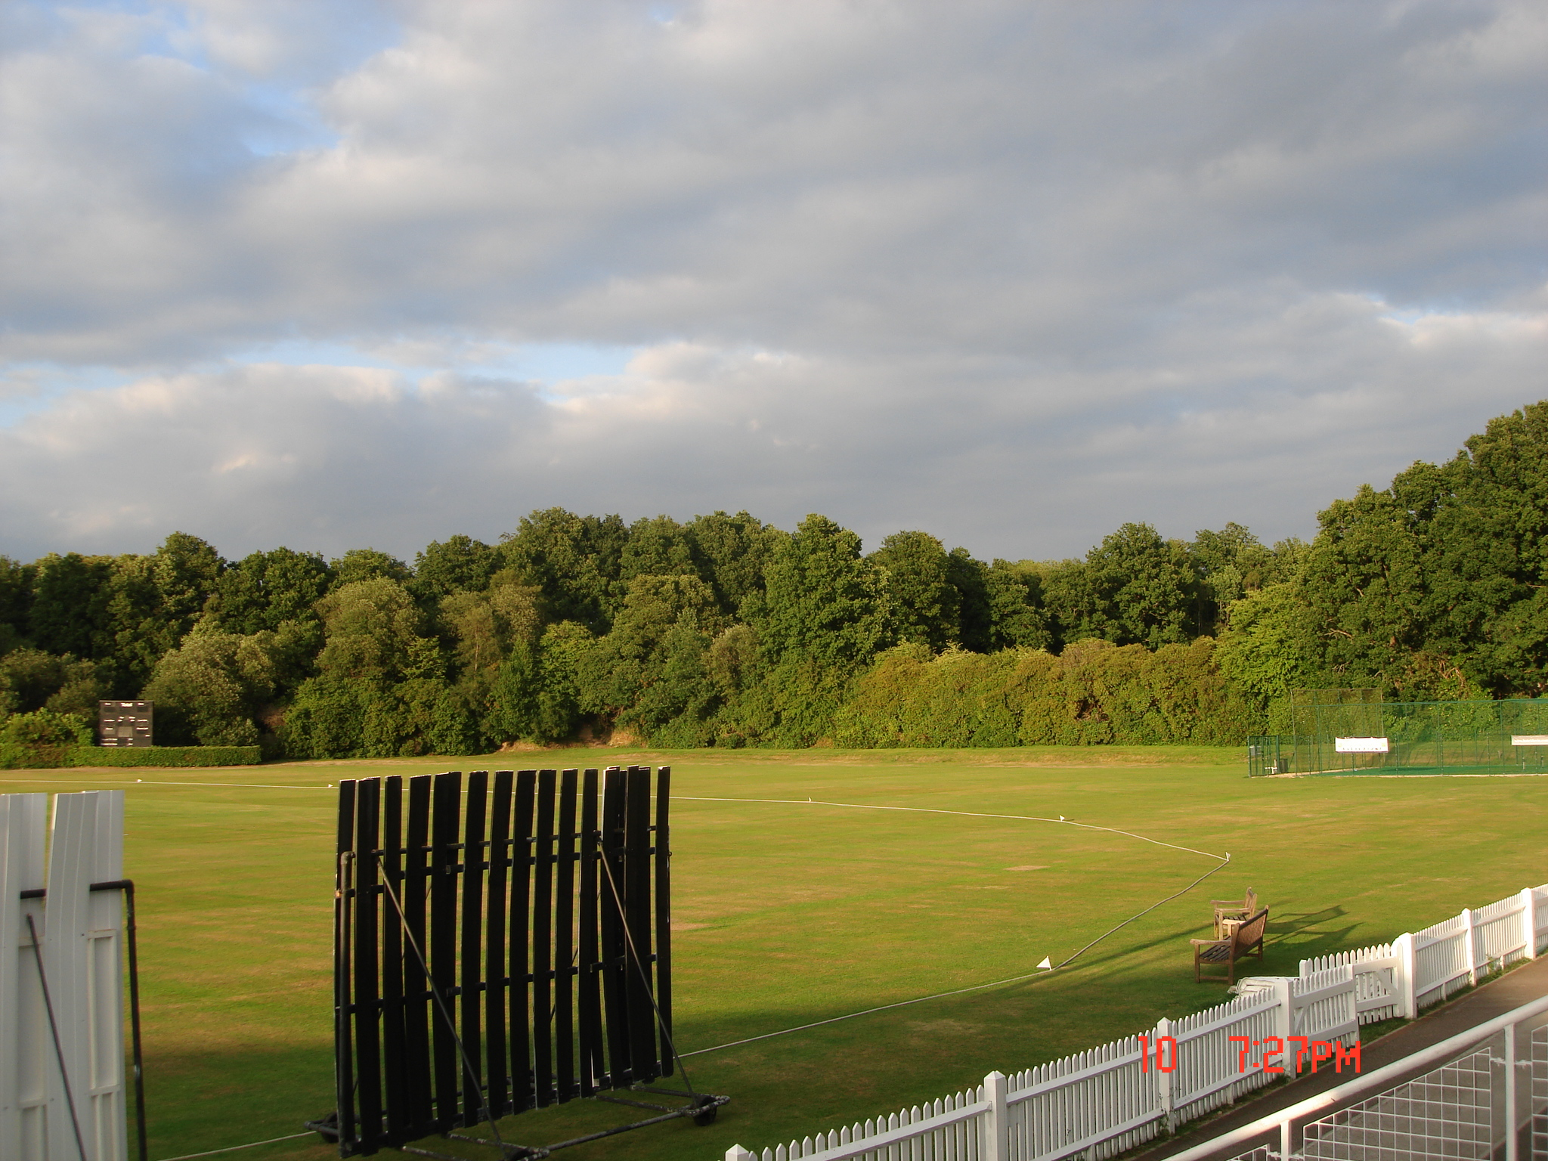
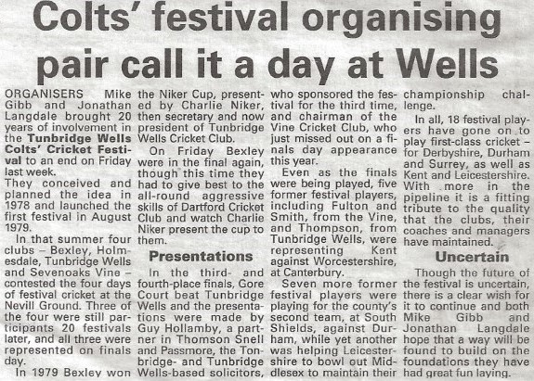

Slide 4
Roll of Honour – 1979 - 1999
Year | Winners | Runners Up | Third Place | Fourth Place
1979 | Bexley | Sevenoaks Vine | No 3rd/4th play off | No 3rd/4th play off
1980 | Bromley | Tunbridge Wells | Gravesend | Beckenham
1981 | Tunbridge Wells | Gravesend | Bromley
1982 | Dartford | Bexley
1983 | Tunbridge Wells | Dartford
1984 | Bromley | Tunbridge Wells
1985 | Bromley | Bexley | Tunbridge Wells
1986 | Bromley | Beckenham | Dartford
1987 | Beckenham | Dartford | Sevenoaks Vine | Bexley
1988 | Beckenham | Bromley | Dartford | Sevenoaks Vine
1989 | Dartford | Beckenham | Sevenoaks Vine | Bromley
Year | Winners | Runners Up | Third Place | Fourth Place
1990 | Beckenham | Tunbridge Wells | Dartford | Sevenoaks Vine
1991 | Beckenham | Dartford | Sevenoaks Vine
1992 | Beckenham | Dartford | Sevenoaks Vine | Bexley
1993 | Tunbridge Wells | Sevenoaks Vine | Bromley | Border League
1994 | Bromley | Bexley | Sevenoaks Vine | Dartford
1995 | Sevenoaks Vine | Tunbridge Wells | Bexley | Border League
1996 | Sevenoaks Vine | Tunbridge Wells | Bexley
1997 | Bromley | Bexley | Gore Court
1998 | Dartford | Bexley | Gore Court | Tunbridge Wells
1999 | Bexley | Lordswood | Bromley
Position placings to be confirmed
1996 Finals Day was washed out without a ball being bowled.
Sevenoaks Vine were crowned winners by obtaining more points during the group stage compared to fellow finalist Tunbridge Wells. Bexley may have achieved 3rd place by accruing 11 points in the group stage.

Slide 5
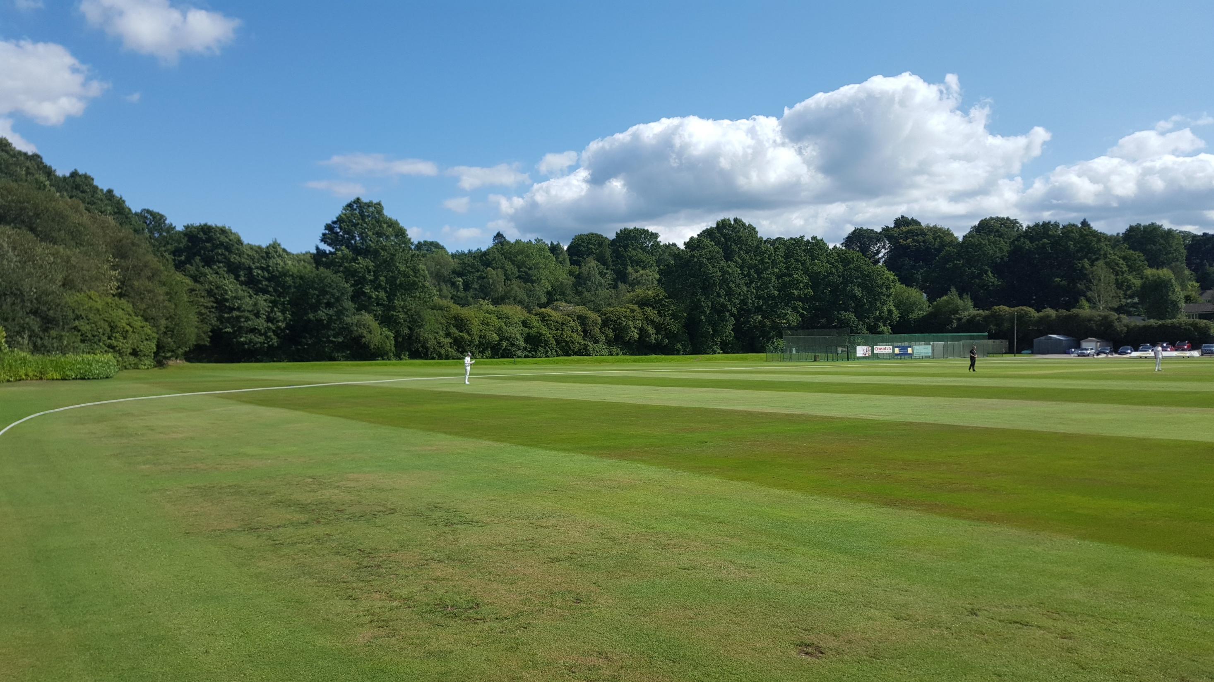
Roll of Honour – 2000 onwards
Year | Winners | Runners Up | Third Place | Fourth Place
2000 | Dartford | Bexley | Tunbridge Wells | Bromley
2001 | Tunbridge Wells | Bexley
2002 | Hayes | Tunbridge Wells | Bexley | Sevenoaks Vine
2003 | Sevenoaks Vine | Bromley | Tunbridge Wells | Lingfield
2004
2005 | Tunbridge Wells | Sevenoaks Vine
2006 | St Lawrence & Highland Court | Bexley
2007 | Tunbridge Wells | Bexley | St Lawrence & Highland Court
2008 | Tunbridge Wells | Banstead | St Lawrence & Highland Court
2009 | Holmesdale | Tunbridge Wells | Blackheath | Bexley
Year | Winners | Runners Up | Third Place | Fourth Place
2010 | Tunbridge Wells | Reigate Priory | Lingfield | Banstead
2011 | Reigate Priory | Banstead | Tunbridge Wells
2012 | Bexley | Lingfield | Banstead | Tunbridge Wells
2013 | Reigate Priory | Bexley | Tunbridge Wells | Banstead
2014 | Reigate Priory | Bexley | Tunbridge Wells
2015 | Bexley | Reigate Priory | Tunbridge Wells | Sevenoaks Vine
2016 | Tunbridge Wells | Reigate Priory | Bexley | Hartley
2017 | Reigate Priory | Hartley
2018 | Bexley | Tunbridge Wells | Bromley | Hartley
2019 | Bromley | Bexley | Reigate Priory | Linton Park
2013 - 3rd/4th Banstead v TWCC- result unknown
2014 – Assumed that TWCC made the 3/4th play off
2015: 3rd & 4th playoff abandoned.
2017 Brighton or Lingfield in 3rd or 4th play off
Position placings to be confirmed

Slide 6
Roll of Honour – 2020 onwards
Year | Winners | Runners Up | Third Place | Fourth Place
2020 | Bexley | Bromley | No 3rd/4th play off | No 3rd/4th play off
2021
2022
2023
2024
2025
2026
2027
2028
2029
Year | Winners | Runners Up | Third Place | Fourth Place
2030
2031
2032
2033
2034
2035
2036
2037
2038
2039

Slide 7
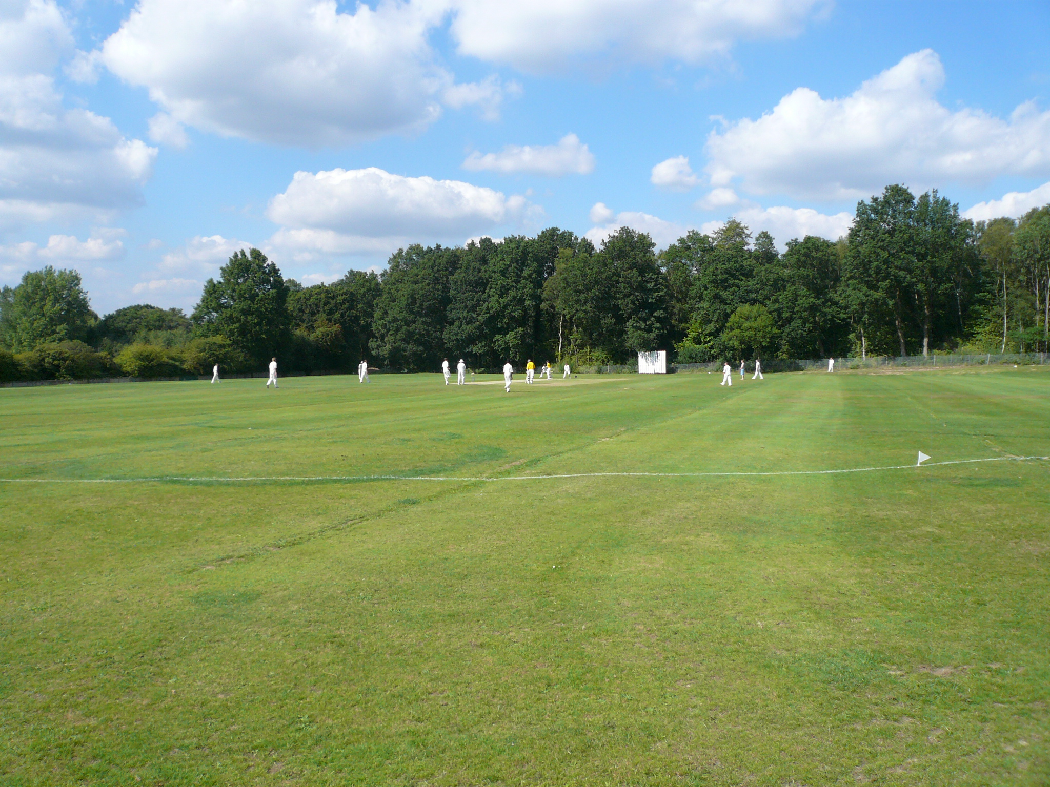
The Batting Award – The Brian Kennett Cup from 1984 onwards
The Bowling Award
Year | Winners | Club
1979
1980 | A Baylis | Tunbridge Wells
1981 | M Holcombe | Bromley
1982
1983
1984 | G Ball | Bexley
1985 | J Longley | Tunbridge Wells
1986 | M Dowse | Beckenham
1987 | J Lowrie | Dartford
1988 | C Gibson | Beckenham
1989 | S Willis | Dartford
Year | Winners | Club
1990 | C Foster | Beckenham
1991 | S Willis | Dartford
1992 | D Terry | Dartford
1993 | W House | Sevenoaks Vine
1994 | M Ladbrook | Bexley
1995 | J McCulley | Sevenoaks Vine
1996 | R Hands | Tunbridge Wells
1997 | J Lincoln | Gore Court
1998 | J Lincoln | Gore Court
Year | Winners | Club
1979
1980
1981
1982
1983
1984 | R O’Sullivan | Bexley
1985
1986 | J Chase | Bromley
1987
1988
1989
Year | Winners | Club
1990
1991
1992 | R Champion | Bexley
1993 | G Stephens | Tunbridge Wells
1994 | E Smith | Sevenoaks Vine
1995 | A Wellard | Bexley
1996 | A Carty | Bexley
1997 | A Carty | Bexley
1998 | T Howes | Dartford

Slide 8
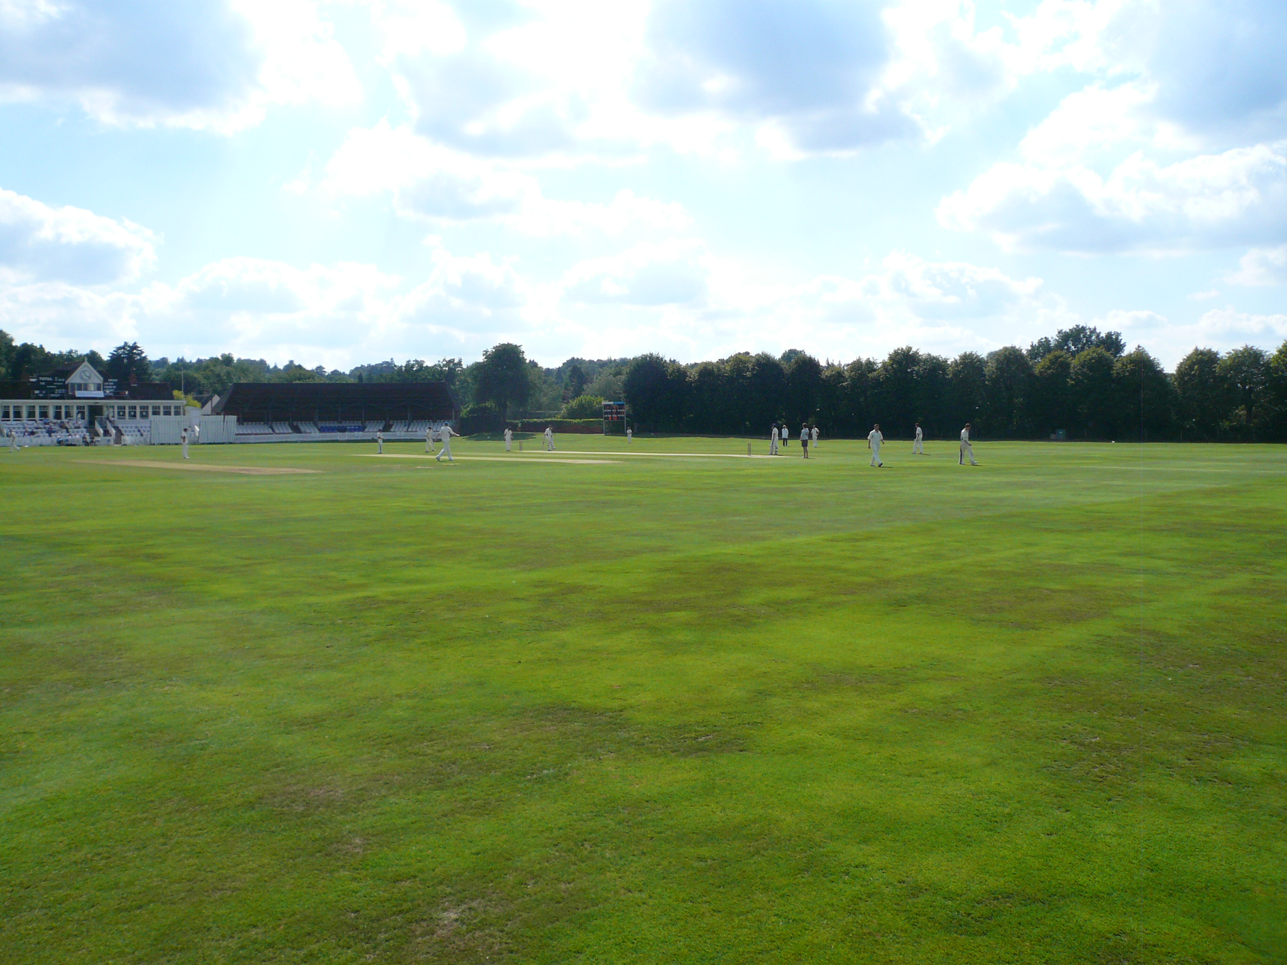
Wicket Keeping Award – “The Hopper Levett Cup”
The Fielding / All-rounder Award
Year | Winners | Club
1979
1980
1981
1982
1983
1984
1985
1986 | R Dummer | Bromley
1987 | G Kersey | Bexley
1988
1989
Year | Winners | Club
1990
1991 | T Appleby | Bexley
1992 | A Boxer | Bexley
1993
1994
1995 | E Tyler | Bexley
1996
1997
1998 | N Stroudley | Bexley
1999
Year | Winners | Club
1979
1980 | J Hinks | Gravesend
1981
1982 | I Willmott | Bexley
1983
1984
1985
1986
1987
1988 | K Ives S Hughes | Dartford Bromley
1989
Year | Winners | Club
1990
1991
1992
1993 | G Stephens | Tunbridge Wells
1994 | M Hughes | Bromley
1995 | T Allen | Bexley
1996
1997
1998
1999

Slide 9
Beckenham
Matthew Brimson:1986 -1988
Robert Key:1993 -1995
Ben Phillips:1991***
Bexley
Rajesh Sharma:1979
Andrew Tutt:1983*
Graham Kersey: 1985 -1988
James Hockley:1994 - 1995
Adam Ball: 2006
Adam Riley: 2006 - 2007
Ollie Robinson: 2015
Border League
Nick Wilton: 1995
Dartford
Trevor Ward:1982
Eddie Stanford:1983 -1987
Simon Willis:1987- 1991
Matthew Walker:1989**
Richard Clinton:1995
Sevenoaks Vine
David Fulton:1985 -1988
Will House:1990,1991 &1993
Ed Smith:1992 -1994
Zak Crawley:2015
Tunbridge Wells
Jonathan Longley:1983 -1985
Julian Thompson:1983 -1985
Marcus O’Riordan:2015
First Class cricketers who played at the Tunbridge Wells Colts Festival
 | Notes
* | A guest player from RACS.
** | A guest player from Gravesend.
*** | A guest player from Hayes but shouldn't have played according to the Festival rules at the time.

Slide 10
Content Changes
Date | Summary of Change/s

